Slide 1
Unit-4
Advanced R Programming

Slide 2
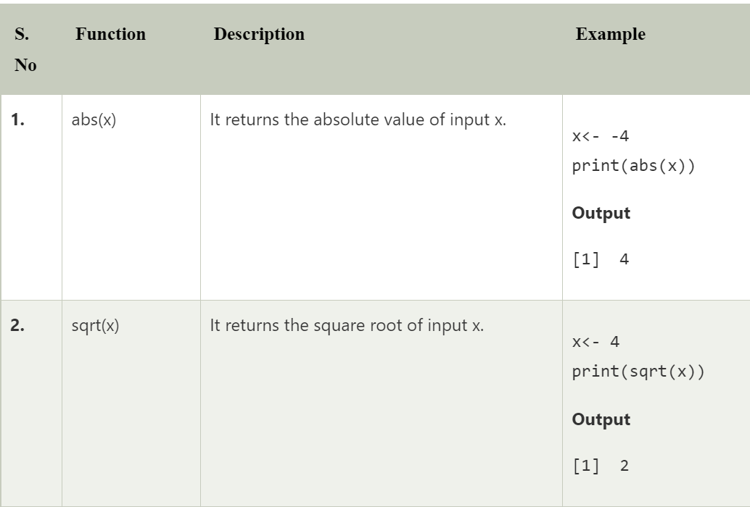
Math Functions

Slide 3
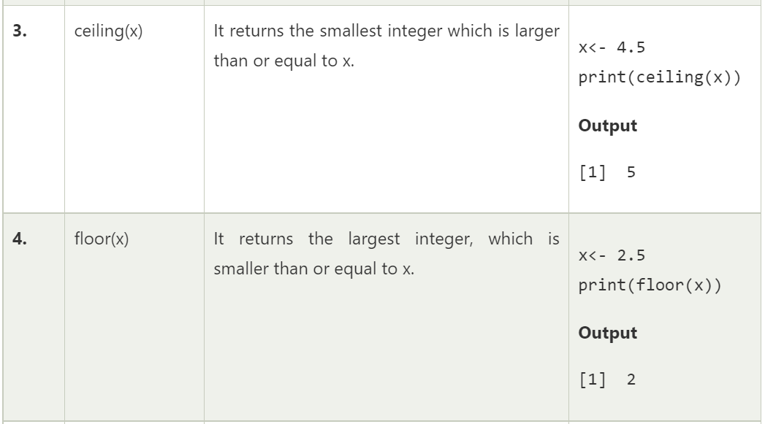

Slide 4
truc(x): truncate the value to the nearest number less than the number
> trunc(5.19)
[1] 5
round(x)
> round(3.475,digit=2)
[1] 3.48

Slide 5
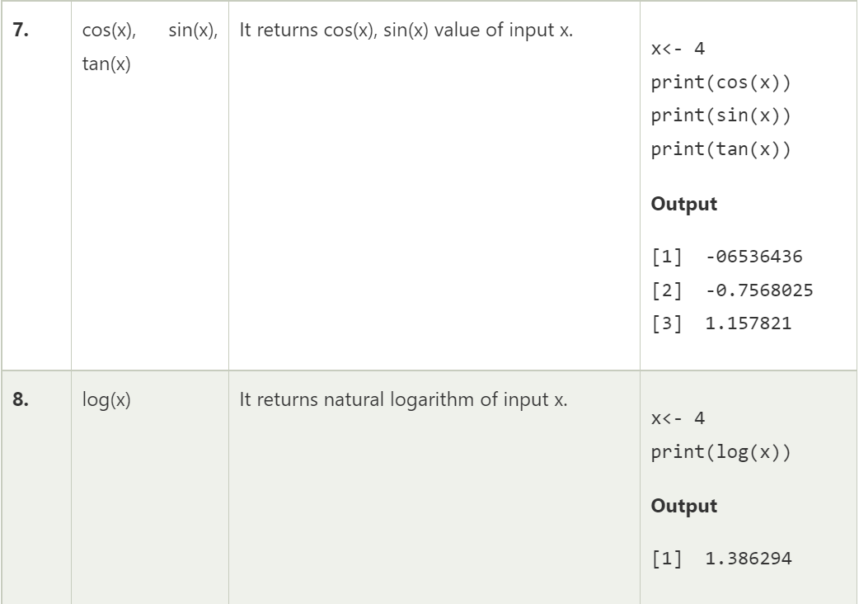

Slide 6
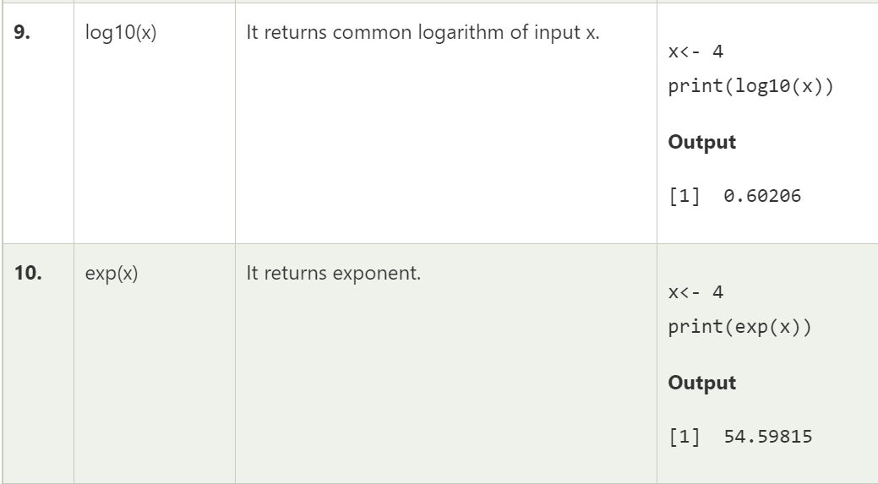

Slide 7
substr: Extract or replaces substrings in a string
> substr("abcdef",2,4)
[1] "bcd“
nchar-no. of character in a string
> str <- "Big Data"
> nchar(str)
[1] 8

Slide 8
Find position of a Matched Pattern in a String in R Programming – grep() Function
grep() function in R Language is used to search for matches of a pattern within each element of the given string.
Syntax: grep(pattern, x, ignore.case=TRUE/FALSE, value=TRUE/FALSE) Parameters: pattern: Specified pattern which is going to be matched with given elements of the string. x: Specified string vector. ignore.case: If its value is TRUE, it ignores case. value: If its value is TRUE, it return the matching elements vector, else return the indices vector.

Slide 9
> x <- c("GFG", "gfg", "xyz", "XYZ")
> # Calling grep() function
> grep("gfg", x)
[1] 2
> grep("xyz", x)
[1] 3
> grep("gfg", x, ignore.case = FALSE)
[1] 2
> grep("xyz", x, ignore.case = TRUE)
[1] 3 4
> x <- c("GFG", "gfg", "xyz", "Xyz")
> grep("xyz", x, ignore.case = TRUE)
[1] 3 4

Slide 10
Replace the First Match of a Pattern from a String in R Programming – sub() Function
sub function in R Language is used to replace the first match of a pattern in a string. If there is a vector of string elements, then it will replace the first match of the pattern from all elements.
Syntax: sub(pattern, replacement, string, ignore.case=TRUE/FALSE)
Parameters:
pattern: string to be matched
replacement: string for replacement
string: String or String vector
ignore.case: Boolean value for case-sensitive replacement

Slide 11
x="Hello world hello“
> sub("ell","owe",x)
[1] "Howeo world hello“
> sub("hel","owe",x,ignore.case=FALSE)
[1] "Hello world owelo"
> sub("hel","owe",x,ignore.case=TRUE)
[1] "owelo world hello"

Slide 12
strsplit() Function in R
The strsplit() in R programming language function is used to split the elements of the specified character vector into substrings according to the given substring taken as its parameter.
> strsplit("xyz","")
[[1]]
[1] "x" "y" "z"

Slide 13
paste(…,sep=“”)
Joins strings after using the sep string to separate them
> strsplit("xyz","")
[[1]]
[1] "x" "y" "z"
> paste("z",1:3,sep="")
[1] "z1" "z2" "z3"
> paste("z",1:3,sep="&Y")
[1] "z&Y1" "z&Y2" "z&Y3"

Slide 14
Str()
It is used to help you examine the structure of data object
x=read.csv(file.choose())
> str(x)
'data.frame': 8 obs. of 5 variables:
$ id : int 1 2 3 4 5 6 7 8
$ name : chr "Rick" "Dan" "Michelle" "Ryan" ...
$ salary : num 623 515 611 729 843 ...
$ start_date: chr "2012-01-01" "2013-09-23" "2014-11-15" "2014-05-11" ...
$ dept : chr "IT" "Operations" "IT" "HR" ...

Slide 15
Summary()
It is designed to give a quick statistical summary of data objects
> summary(x)
id name salary
Min. :1.00 Length:8 Min. :515.2
1st Qu.:2.75 Class :character 1st Qu.:602.8
Median :4.50 Mode :character Median :628.0
Mean :4.50 Mean :656.9
3rd Qu.:6.25 3rd Qu.:724.1
Max. :8.00 Max. :843.2
start_date dept
Length:8 Length:8
Class :character Class :character
Mode :character Mode :character

Slide 16
toupper(x)- changes the letter of string to uppercase
Tolower(x)- changes the letter of string to lowercase
> toupper("aashima")
[1] "AASHIMA"
> tolower("AASHIMA")
[1] "aashima"
> tolower("Aashima")
[1] "aashima"

Slide 17
Apply Family of Functions
Functions present in the apply family are the ones that allow us to manipulate data frames, arrays, matrices, vectors. These functions are alternative to the loops. However, are more efficient than loops as functions are faster at the execution level. These functions reduce the need for explicitly creating a loop in R. Following is the list of functions that are a part of the apply family.
The apply() function
The lapply() function
The sapply() function
The tapply() function
The mapply() function

Slide 18
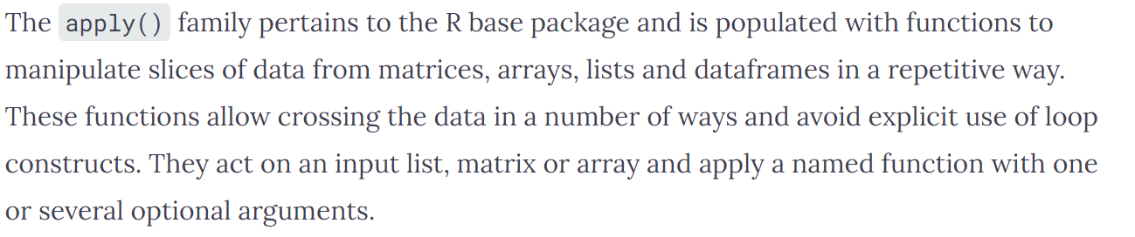
Apply()

Slide 19
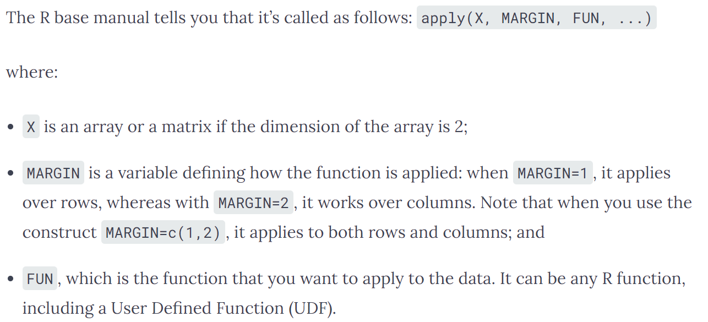

Slide 20
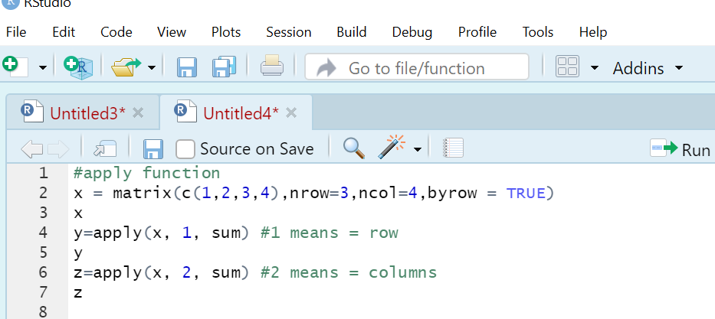

Slide 21
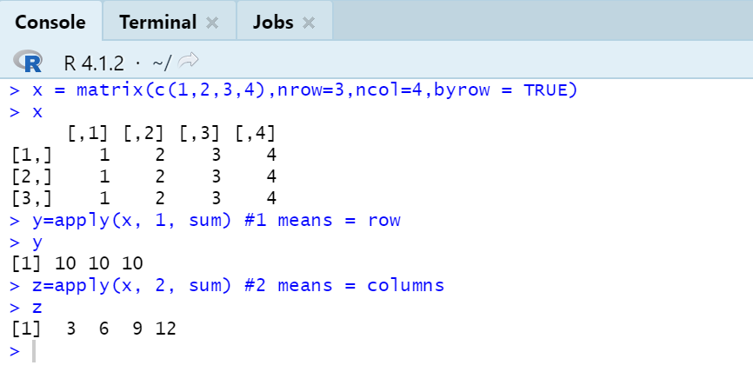

Slide 22
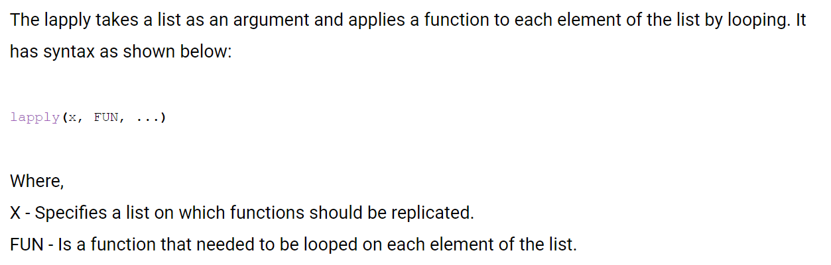
Lapply()

Slide 23
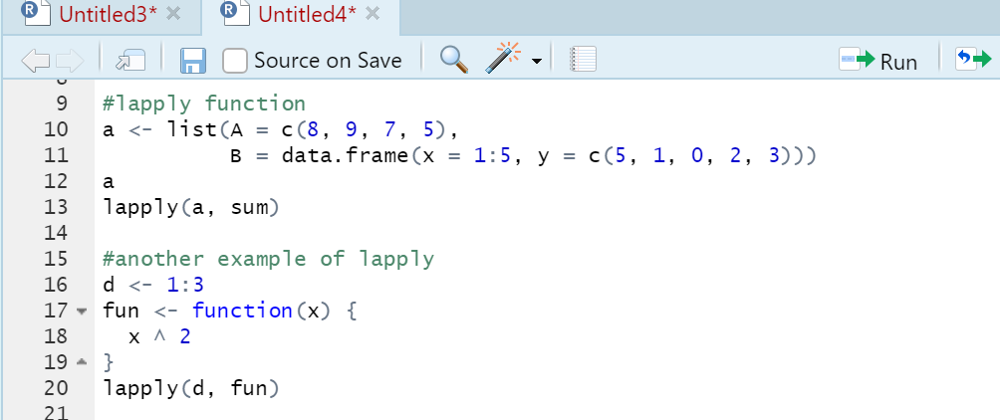

Slide 24
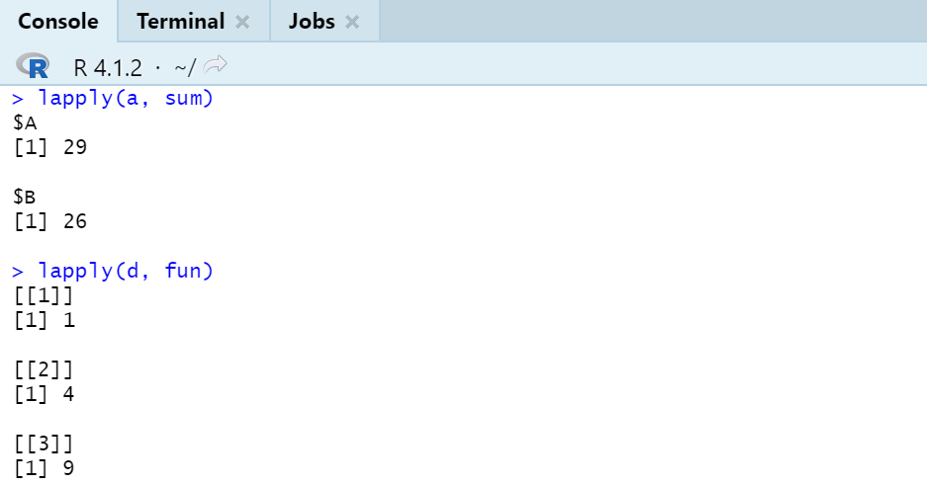

Slide 25
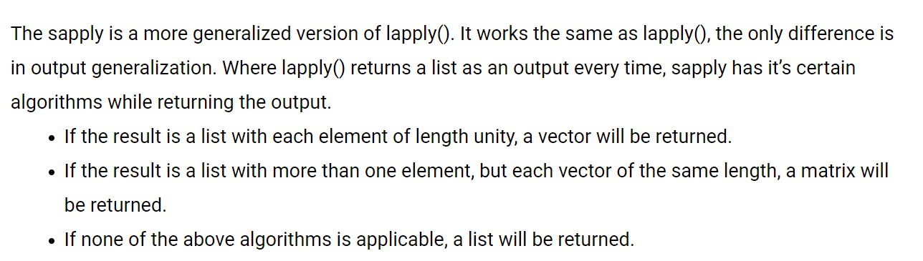
Sapply()

Slide 26
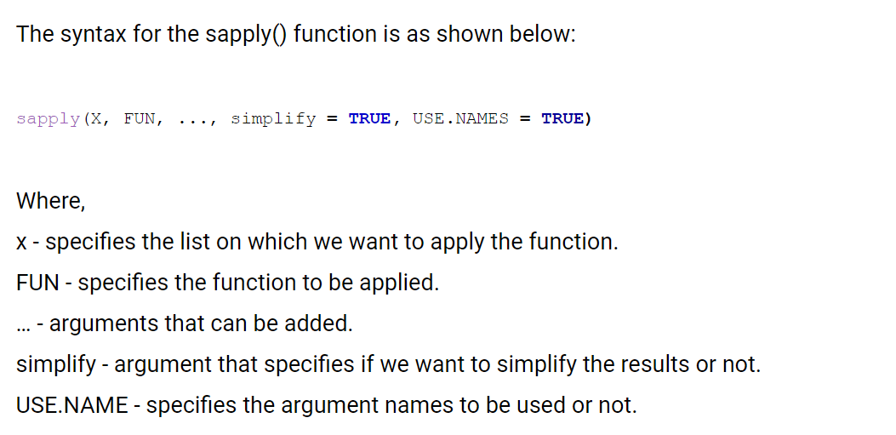

Slide 27
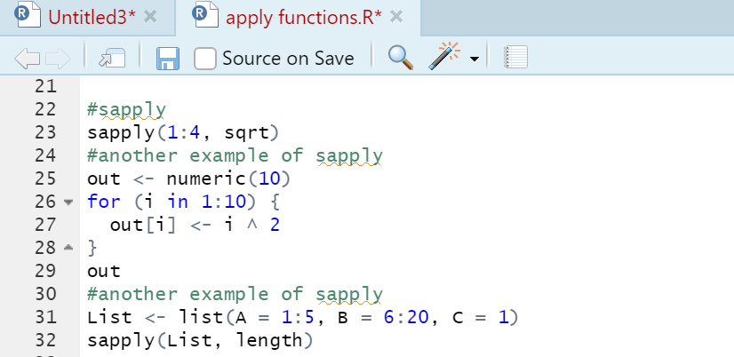

Slide 28
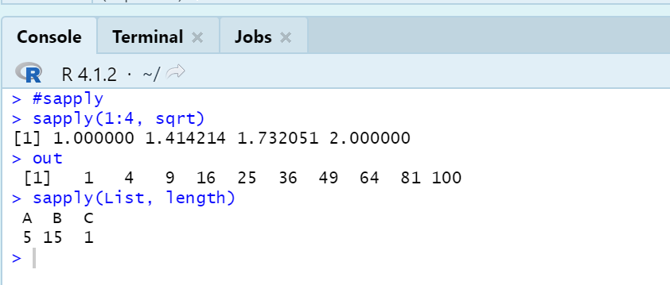

Slide 29
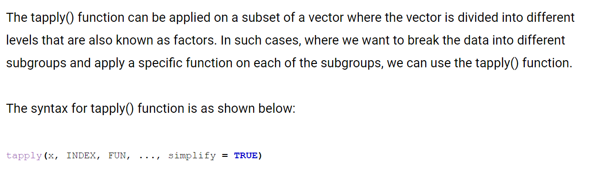
Tapply()

Slide 30
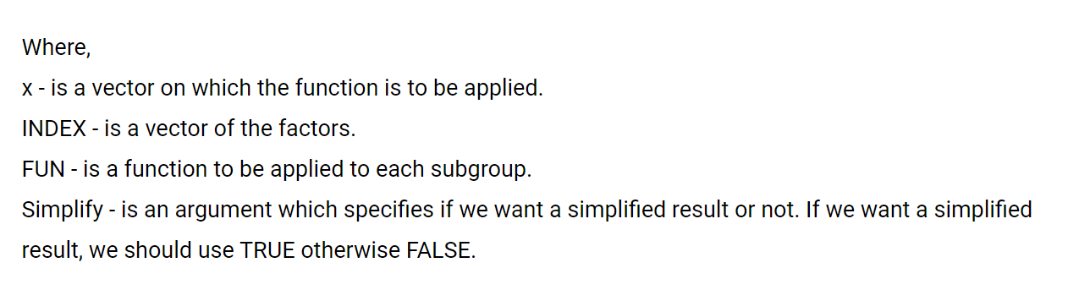

Slide 31
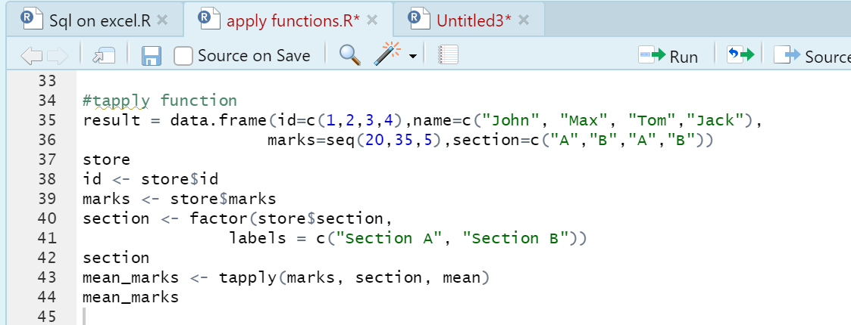

Slide 32
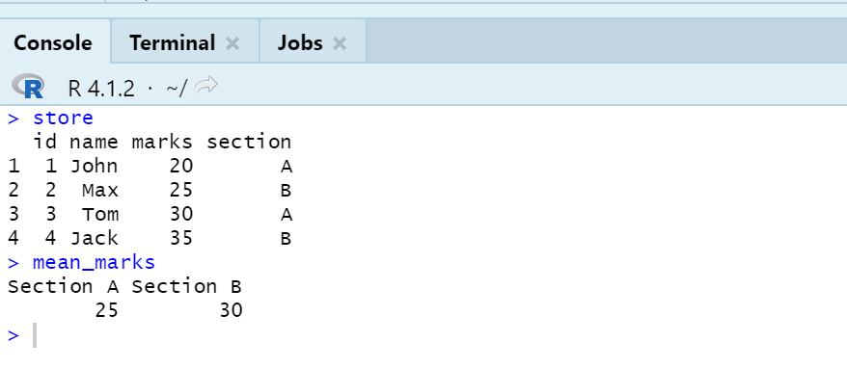

Slide 33
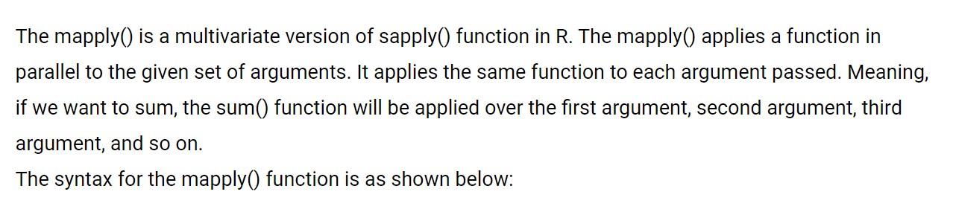
Mapply()

Slide 34
